Slide 1

DRIVER DROWSINESS DETECTION USING MACHINE LEARNING
NAME: SELINA NAYAK,STUTI PATTNAIK,TAPASWINI HALDAR
REDG NO: 2001106516,2001106520,2112100041
BRANCH: INFORMATION TECHNOLOGY
SEMESTER: 8
GROUP : 9
Guided by : MR. DEBI PRASAD MISHRA

Slide 2
CONTENTS
INTRODUCTION
MOTIVATION
LITERATURE SURVEY
OBJECTIVE
PROBLEM STATEMENT
PROPOSED SYSTEM
SYSTEM DESIGN
COMPONENTS OF PROPOSED SYSTEM
REQUIREMENT SPECIFICATION
HAAR CASCADE CLASSIFIERS
OUTPUT
CONCLUSION
REFERENCES

Slide 3
INTRODUCTION
The driver drowsiness detection project is designed to prevent accidents caused by drivers becoming drowsy while driving.
The project is built using Python programming language and utilizes the OpenCV library for computer vision tasks.
The prevalence of driver drowsiness and its associated risks pose significant challenges to road safety. Fatigue-related accidents can have severe consequences, leading to injuries, loss of life, and property damage.
To address this issue, the driver drowsiness detection project has been developed using Python and the OpenCV library.

Slide 4
MOTIVATION
The motivation behind the driver drowsiness detection project using machine learning stems from
address the alarming rate of accidents caused by drowsy driving
innovative solutions that can mitigate the risks associated with driver fatigue.
Ultimately, the primary goal of this project is to enhance road safety by providing timely alerts or interventions to prevent accidents caused by drowsy driving.

Slide 5
LITERARY SURVEY
SL NO. | AUTHOR | DESCRIPTION | ADVANTAGE | DISADVANTAGE
1. | Ceerthi Bala U.K and Sarath TV | This system will provide an alert to the driver in case of drowsiness detection | Once it is detected with the particular sensor, the system will alert the driver | Low Accuracy
2. | Rateb Jabbar et al | Developed a drowsiness system model using CNN for mobile application | When developed model applies with the real time camera,the drowsiness can be detected considerably | As a result, they found 88% accuracy without glass, and a glass system detects 85% accuracy

Slide 6
LITERARY SURVEY
SL NO | AUTHOR | DESCRIPTION | ADVANTAGE | DISADVANTAGE
3. | Dr.K.S.Tiwari | A study to identify drowsiness detection with IoT technology | A buzzer and camera placed with a microcontroller continuously monitor the drowsiness with the necessary parameters | It was not detected with glass
4. | Md. Yousuf Husain and Fabian Parsia George | A Raspberry Pi controller pretends as a hub of this system. A camera module, buzzer, and IoT devices are connected with the controller. | A Raspberry Pi controller pretends as a hub of this system. A camera module, buzzer, and IoT devices are connected with the controller | Mail sent to other person

Slide 7
OBJECTIVE
The proposed system aims to bridge the gap between driver drowsiness detection by integrating the insights from both domains. It leverages the existing driver drowsiness detection framework.
The main objective is to first design a system to detect driver’s drowsiness by continuously monitoring retina of the eye.

Slide 8
PROBLEM STATEMENT:
The prevalence of driver drowsiness and its associated risks pose significant challenges to road safety. Fatigue-related accidents can have severe consequences, leading to injuries, loss of life, and property damage.
To address this issue, the driver drowsiness detection project has been developed.By leveraging computer vision techniques, this project aims to detect signs of drowsiness in drivers and prevent accidents caused by driver fatigue.

Slide 9
PROPOSED SYSTEM
Visual object tracking
Facial landmarks recognition
Driver drowsiness detection
Determination of eyes and mouth regions : The region of the eyes, Evaluation of the driver’s fatigue state
Eye status recognition
Alarm Sound
Self Mode alert

Slide 10
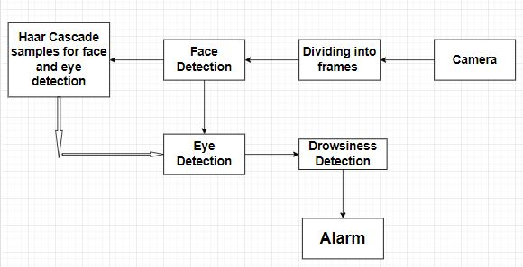
SYSTEM DESIGN

Slide 11
COMPONENTS OF DRIVER DROWSINESS DETECTION SYSTEM
Data Collection:Capture frames from a camera feed using OpenCV's VideoCapture module. Convert the frames to grayscale for better processing efficiency.
Face and Eye Detection: Utilize Haar cascade classifiers for face and eye detection. Apply the cascades to identify faces and eyes in the grayscale frames.
Drowsiness Detection:Calculate the Eye Aspect Ratio (EAR) to determine eye openness.Monitor the EAR over a time interval to track eye activity.If the EAR drops below a threshold for a certain period, trigger drowsiness alert.
Alert Mechanism:Emit a sound alarm to warn the driver of potential drowsiness.Display visual alerts on the screen, such as blinking text or icons.

Slide 12
REQUIREMENT SPECIFICATION
HARDWARE REQUIREMENTS
System: Inter core i5
Hard drive: 256 gb
Mouse :Any mouse
RAM: 4GB

Slide 13
SOFTWARE REQUIREMENTS
Operating System: Windows 10
Coding Language: Python 3.7

Slide 14
HAAR CASCADE CLASSIFIERS FOR FACE AND EYE DETECTION
Haar Cascade classifiers are an effective way for object detection. This method was proposed by Paul Viola and Michael Jones in their paper Rapid Object Detection using a Boosted Cascade of Simple Features .Haar Cascade is a machine learning-based approach where a lot of positive and negative images are used to train the classifier.
Positive images – These images contain the images which we want our classifier to identify.
Negative Images – Images of everything else, which do not contain the object we want to detect.

Slide 15
CONTINUED
The algorithm can be explained in four stages:
Calculating Haar Features
Creating Integral Images
Using Adaboost
Implementing Cascading Classifiers

Slide 16
EYE ASPECT RATIO
The Eye Aspect Ratio is an estimate of the eye opening state.
The eye aspect ratio can be defined by the below equation. ... A program can determine if a person's eyes are closed if the Eye Aspect Ratio falls below a certain threshold.
FORMULA
||P2-P6||+||P3-P5||
EAR= 2||P1-P4||

Slide 17
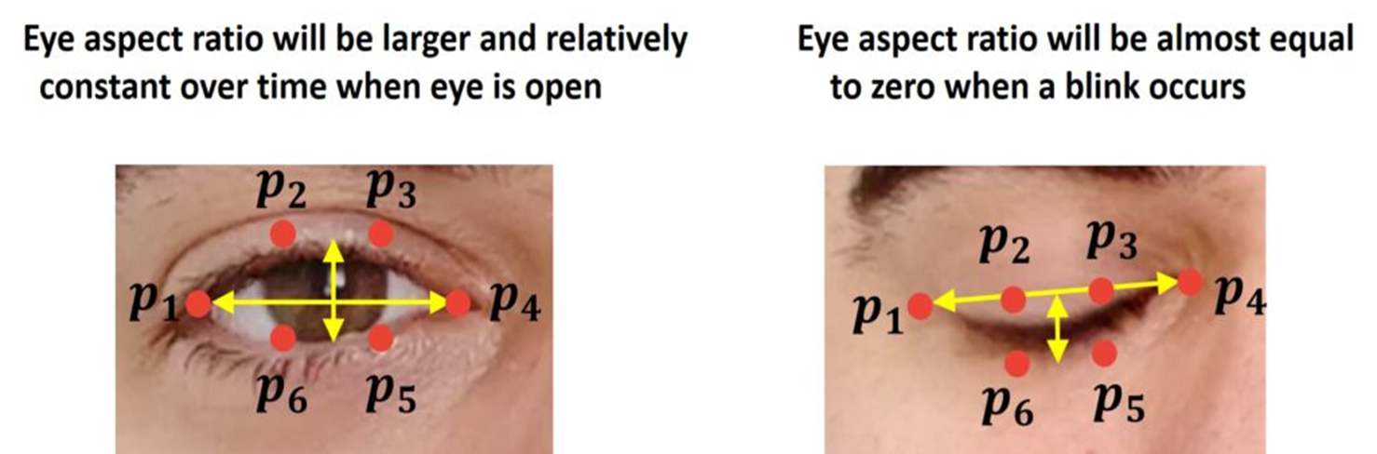
CONTINUED

Slide 18
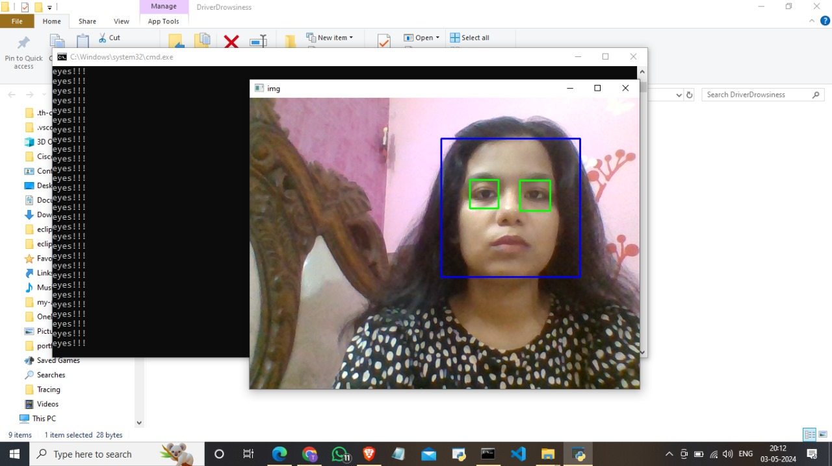
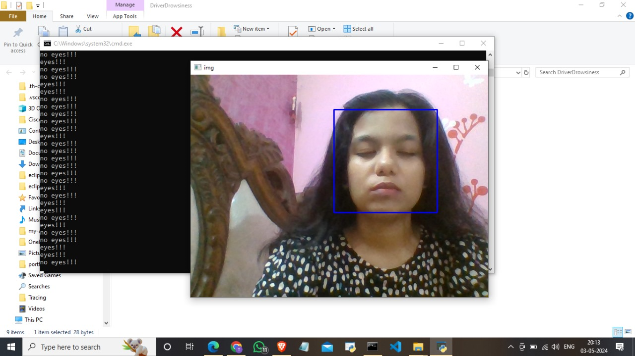
OUTPUT:

Slide 19
CONCLUSION
In conclusion, the development of a driver drowsiness detection project using Python and the OpenCV library represents a significant step toward enhancing road safety and preventing accidents caused by driver fatigue.
The integration of Haar cascade classifiers for face and eye detection, along with the calculation of the Eye Aspect Ratio (EAR), enables accurate assessment of eye openness.
The implemented drowsiness detection algorithm, combined with configurable settings and alert mechanisms, ensures that the system can be tailored to individual preferences and sensitivity levels.
The user interface provides an intuitive platform for drivers to monitor their own alertness and take necessary actions to stay attentive on the road.

Slide 20
REFERENCES
[1] Agarwal, Apoorv, Fadi Biadsy, and Kathleen R. Mckeown. "Contextual phrase-level polarity
analysis using lexical affect scoring and syntactic n-grams." Proceedings of the 12th Conference of the European Chapter of the Association for Computational Linguistics. Association for Computational Linguistics, 2009.
[2] Barbosa, Luciano, and Junlan Feng. "Robust sentiment detection on twitter from biased and noisy data." Proceedings of the 23rd international conference on computational linguistics: posters. Association for Computational Linguistics, 2010.
[3] Bermingham, Adam, and Alan F. Smeaton. "Classifying sentiment in microblogs: is brevity an advantage?." Proceedings of the 19th ACM international conference on Information and knowledge management. ACM, 2010.

Slide 21
REFERENCES
[4] Gamon, Michael. "Sentiment classification on customer feedback data: noisy data, large feature vectors, and the role of linguistic analysis." Proceedings of the 20th international conference on Computational Linguistics. Association for Computational Linguistics, 2004.
[5] Kim, Soo-Min, and Eduard Hovy. "Determining the sentiment of opinions." Proceedings of the 20th international conference on Computational Linguistics. Association for Computational Linguistics, 2004.
[6] Klein, Dan, and Christopher D. Manning. "Accurate unlexicalized parsing." Proceedings of the 41st Annual Meeting on Association for Computational Linguistics-Volume 1. Association for
Computational Linguistics, 2003.

Slide 22
THANK YOU

